Slide 1
Unit of Work
.NET Development

Slide 2
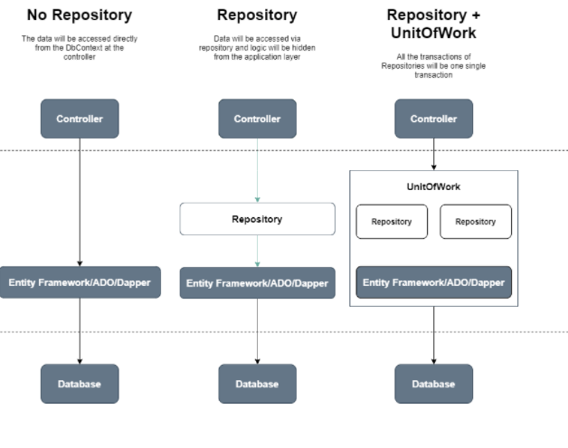
3 approaches for data access
In the course ASP.NET MVC, we used no repository.
In previous chapter we create an extra layer called a Repository which encapsulates the Data Access Layer.
This chapter the Unit Of Work pattern is explained which let us work with transactions.
Notes:
View in pres entation mode repository is used because you don’t need to change any code in your project if you change from data access (ORM) tool + writing tests only once + more readable
Method 1: create interface (fixed calls for different crud operations) ->generic inject DBContext in ClassRepository that uses interface
Method 2: create generic interface + repository that all classes can use

Slide 3
The concept
Almost all software interacts (CRUD) with a database system.
.Net developers use ORM tools like Entity Framework or Dapper to access these databases smoothly and efficiently.
BUT the concern is how to use these ORM tools to write code that is
reusable
maintainable
readable
and above all testable
This is were design patterns focus on. The repository and unit of work pattern try to solve common problems with database access and business logic transactions.

Slide 4
Unit of Work
Unit of Work is referred to as a single transaction that involves multiple operations of insert/update/delete
Examples
- Bank transaction: transferring money from one account to another
- A tennis court reservation: mark the court time slot as occupied, assign the reservation to the player
- Placing an order and adjusting the stock
⇨ it must either be complete in its entirely or have no effect whatsoever

Slide 5
What is Unit of Work?
The Unit of Work will merge all the methods/actions/operations (Create/Update/Delete) of Repositories into a single transaction.
All changes will be committed only once.
They will be rolled back if any action fails to ensure data integrity.

Slide 6
Repositories without Unit Of Work
Can we insert an order and adjust the stock of the product in one single transaction?
OrderController: orderRepository and productRepository are injected
Each repository will maintain its own DBContext class
Each DBContext has its own in-memory list of changes of the entities (1 Order added, 1 Product updated)
It is impossible to save the changes of both DbContext's (SaveChanges) in one transaction (complete in its entirely or have no effect whatsoever)?
Solution?
One DBContext, one SaveChanges
orderRepository with its own DbContext
OrderController
productRepository with its own DbContext

Slide 7
Repositories with Unit of Work
To avoid inconsistent transactions, we will add another layer between the controller and the repositories.
This layer will act as a centralized store for all the repositories to receive the same instance of the DbContext.
This will ensure that, for a unit of transaction that spans across multiple repositories, it should either complete for all entities or should fail and rollback entirely. We can call SaveChanges of UOW.
UnitOfWork class provides DbContext instance
orderRepository receives DbContext
OrderController
productRepository receives DbContext
Notes:
In the above representation, during a single operation, that involves Movie and Rating entities, both of them use the same DbContext instance. This will ensure that even if one of them breaks, the other one is also not saved, thus maintaining the database consistency. So when SaveChanges is executed, it will be done for both of the repositories.

Slide 8
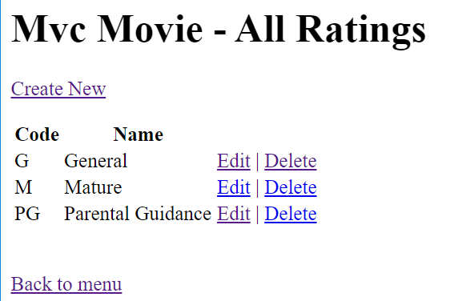
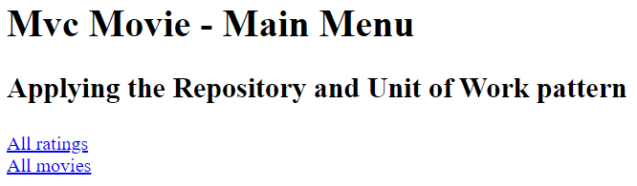
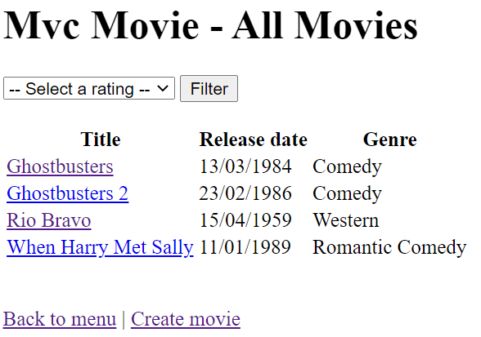
Demo
Open the MVCMovieDemo UOW - start (end of repository part 2)
Run the application.
Notes:
This start application is the end of the repository pattern app

Slide 9
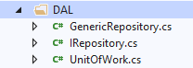
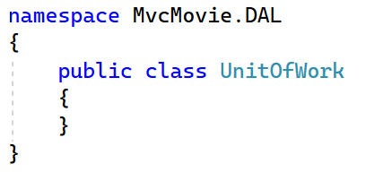
Create UnitOfWork class in DAL
DAL | Add new item | Class ‘UnitOfWork’

Slide 10
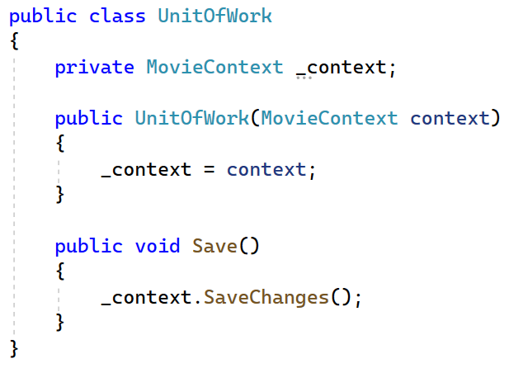
Create UnitOfWork class in DAL
The unit of work class serves one purpose: to make sure that when you use multiple repositories (Movies/Ratings), they share a single database context.
That way, when a unit of work is complete you can call the SaveChanges method on that shared instance of the context and be assured that all related changes will be committed or rolled back.

Slide 11
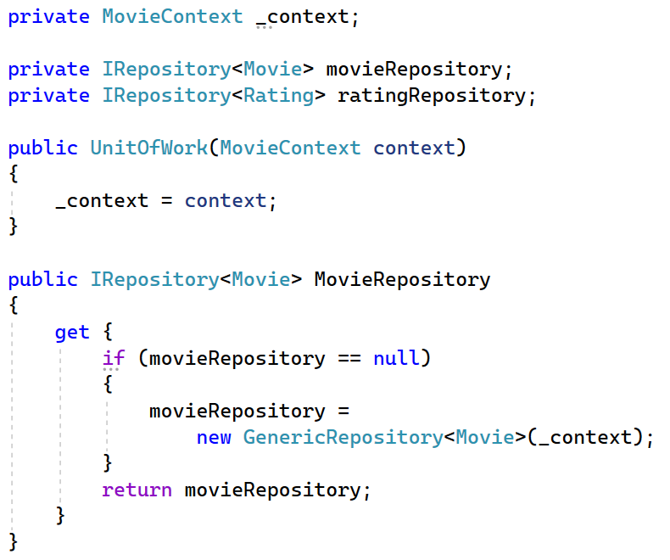
Create UnitOfWork class in DAL
Furthermore, the class needs a getter for each repository.
Each repository property returns a repository instance that has been instantiated using the same database context instance as the other repository instances.
MovieRepository
Notes:
Each repository property checks whether the repository already exists. If not, it instantiates the repository, passing in the context instance. As a result, all repositories share the same context instance.

Slide 12
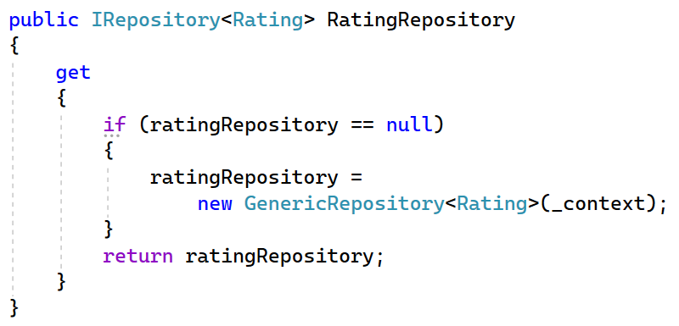
Create UnitOfWork class in DAL
Furthermore, the class needs a getter for each repository.
Each repository property returns a repository instance that has been instantiated using the same database context instance as the other repository instances.
RatingRepository
Notes:
Each repository property checks whether the repository already exists. If not, it instantiates the repository, passing in the context instance. As a result, all repositories share the same context instance.

Slide 13
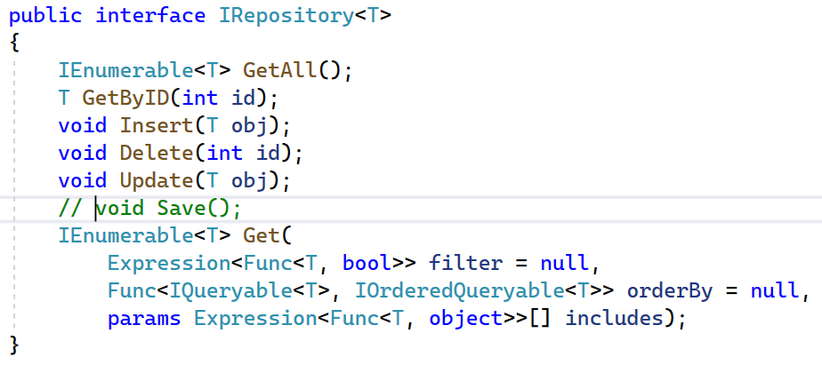
Change IRepository & GenericRepository class
The UnitOfWork class controls now all the changes to the database. The repositories don’t need a Save method anymore.

Slide 14
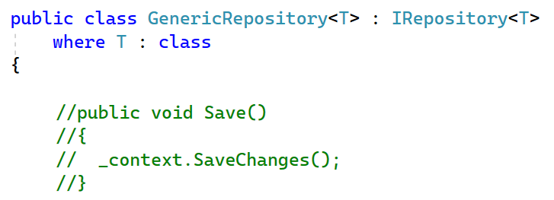
Change IRepository & GenericRepository class

Slide 15
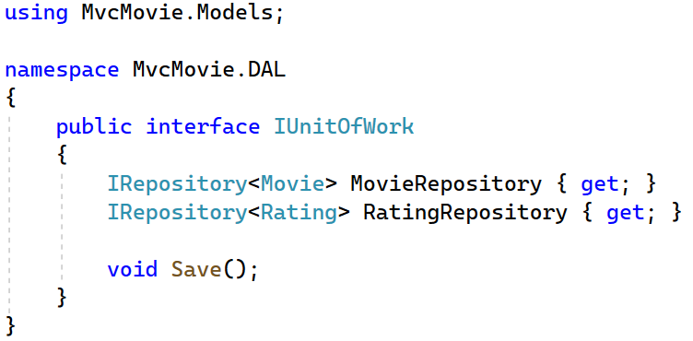
Create IUnitOfWork interface in DAL
Because of DI and testability we want to create an interface for this UnitOfWork class. We will inject this interface in our ASP.NET MVC Controllers later on.

Slide 16
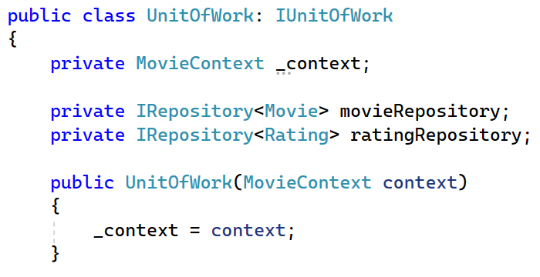
Implement the IUnitOfWork interface

Slide 17
Register IUnitOfWork as a dependency
Program.cs
Remove the previous registrations of the repositories
Add UnitOfWork
X

Slide 18
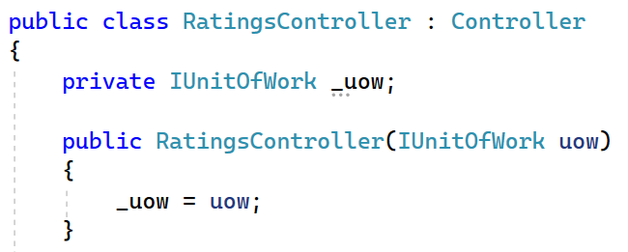
Change the RatingsController to use UOW
The controller now declares a class variable for an object that implements the IUnitOfWork interface. In the constructor the UnitOfWork class is injected in the controller
In the CRUD methods, the UnitOfWork class need to be called.

Slide 19
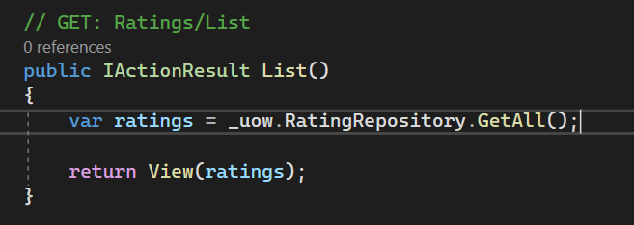
Change the RatingsController to use UOW
public IActionResult List()
{
return View(ratingRepository.GetAll());
}

Slide 20
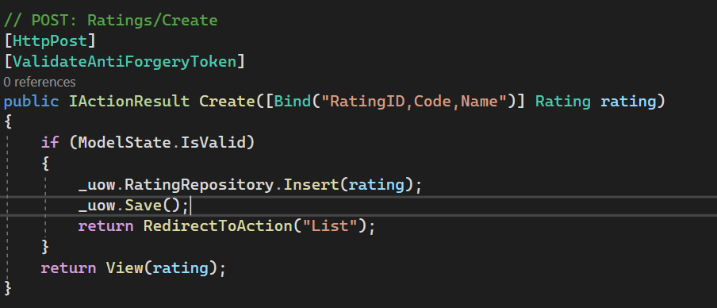
Change the RatingsController to use UOW
public IActionResult Create([Bind("RatingID,Code,Name")] Rating rating)
{
if (ModelState.IsValid)
{
ratingRepository.Insert(rating);
ratingRepository.Save();
return RedirectToAction("List");
}
return View(rating);
}

Slide 21
Exercise
Complete the RatingsController
Change the MoviesController to use UOW
Change XRepository → _ouw.Xrepository or _uow.Save()

Slide 22
Run the application
The project runs as smoothly as before. However, in both controllers the ‘Save’ call only refers to one entity that needs a database change.
CUD in RatingsController: DbSet<Ratings> ⬄ table Rating
C in MoviesController: DbSet<Movies> ⬄ table Movie
The purpose of the UnitOfWork pattern becomes more clear when the changes in both DbSets need to be committed to the database in one single SaveChanges-request.

Slide 23
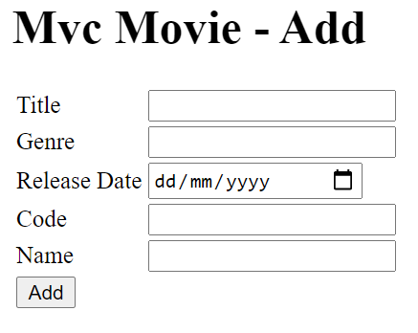
One Single Transaction
Add an extra tag helper in Home/Index.cshtml
A new Movie is inserted with a corresponding Rating.
When the combination rating code and name doesn’t exist a new Rating is added immediately
<a asp-controller="Ratings" asp-action="List">All Ratings</a>
<br />
<a asp-controller="Movies" asp-action="List">All Movies</a>
<br />
<a asp-controller="Movies" asp-action="Add">Add Movie</a>

Slide 24

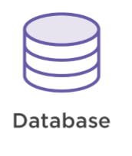
Create movie with new rating in 1 transaction
Unit of Work
Get rating
(check if exists)
Get rating
Rating Repository
Rating entity
(or null)
Rating record

Slide 25
Create movie with new rating in 1 transaction
Unit of Work
Get rating
(check if exists)
Get rating
Rating Repository
Rating entity
(or null)
Rating record
Create rating

Slide 26
Create movie with new rating in 1 transaction
Unit of Work
Get rating
(check if exists)
Get rating
Rating Repository
Rating entity
(or null)
Rating record
Create rating
Create movie
Movie Repository

Slide 27
Create movie with new rating in 1 transaction
Unit of Work
Get rating (check if exists)
Get rating
Rating Repository
Rating entity
(or null)
Rating record
Create rating
Create movie
Movie Repository
1 transaction to the database
Save Changes
Commit changes

Slide 28
Edit views
Add view ‘Add.cshtml’ in the Movies folder
(from resources)
The view contains input/output fields for
a Movie Entity
a string Code
a string Name
What do you need to provide/retrieve those fields?

Slide 29
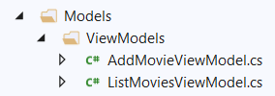
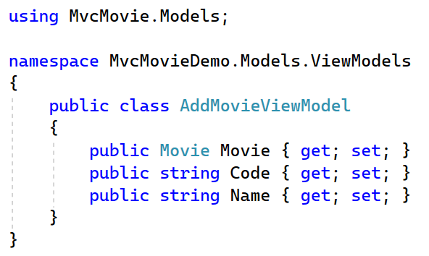
Create new ViewModel
Create a new class AddMovieViewModel in folder Models/ViewModels

Slide 30
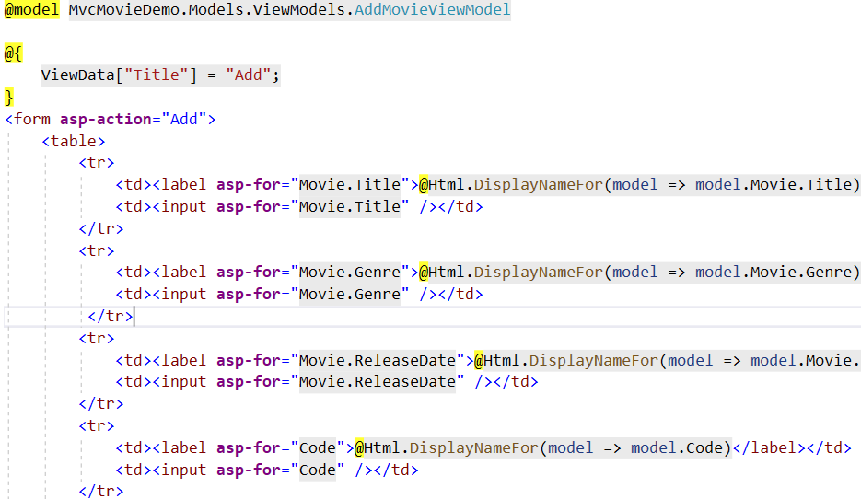
Add.cshtml

Slide 31
Extend MovieController (GET) - from resources
Create an (empty) instance of the AddMovieViewModel class and pass it to the corresponding view
//GET: Movies/Add
public IActionResult Add()
{
var addMovieVM = new AddMovieViewModel();
addMovieVM.Movie = new Movie();
return View(addMovieVM);
}

Slide 32
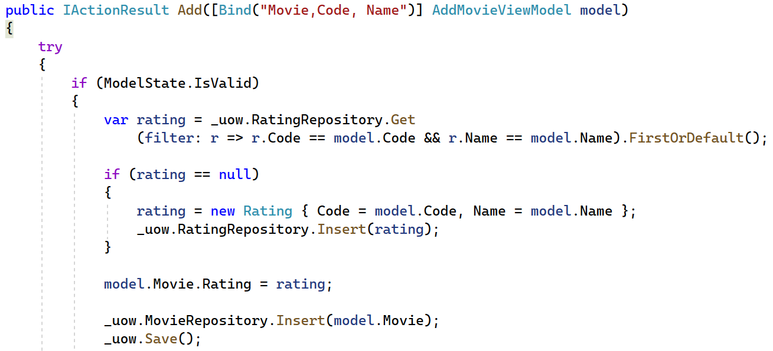
Extend MovieController (POST) - from resources
new Rating in DbSet<Rating>
1 transaction to the DB unitOfWork.Save()
new Movie in DbSet<Movie>

